Slide 1




ONLINE RETAIL – REVENUE ANALYSIS
View in Power BI
Last data refresh:
6/27/2023 5:55:08 AM UTC
Downloaded at:
6/27/2023 7:31:37 AM UTC

Slide 2
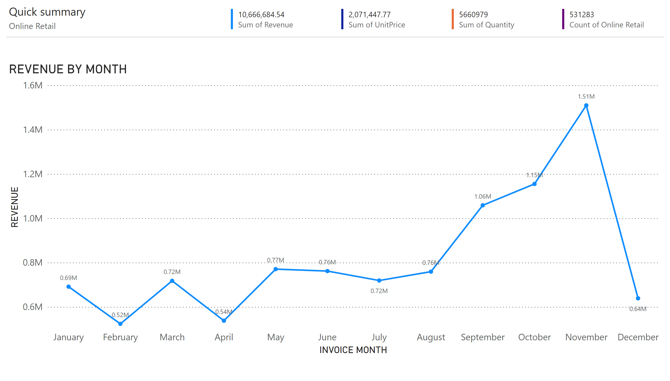
Ques1
Notes:
textbox
No alt text provided
textbox
No alt text provided
multiRowCard
No alt text provided
multiRowCard
No alt text provided
multiRowCard
No alt text provided
multiRowCard
No alt text provided
shape
No alt text provided
REVENUE BY MONTH
No alt text provided

Slide 3
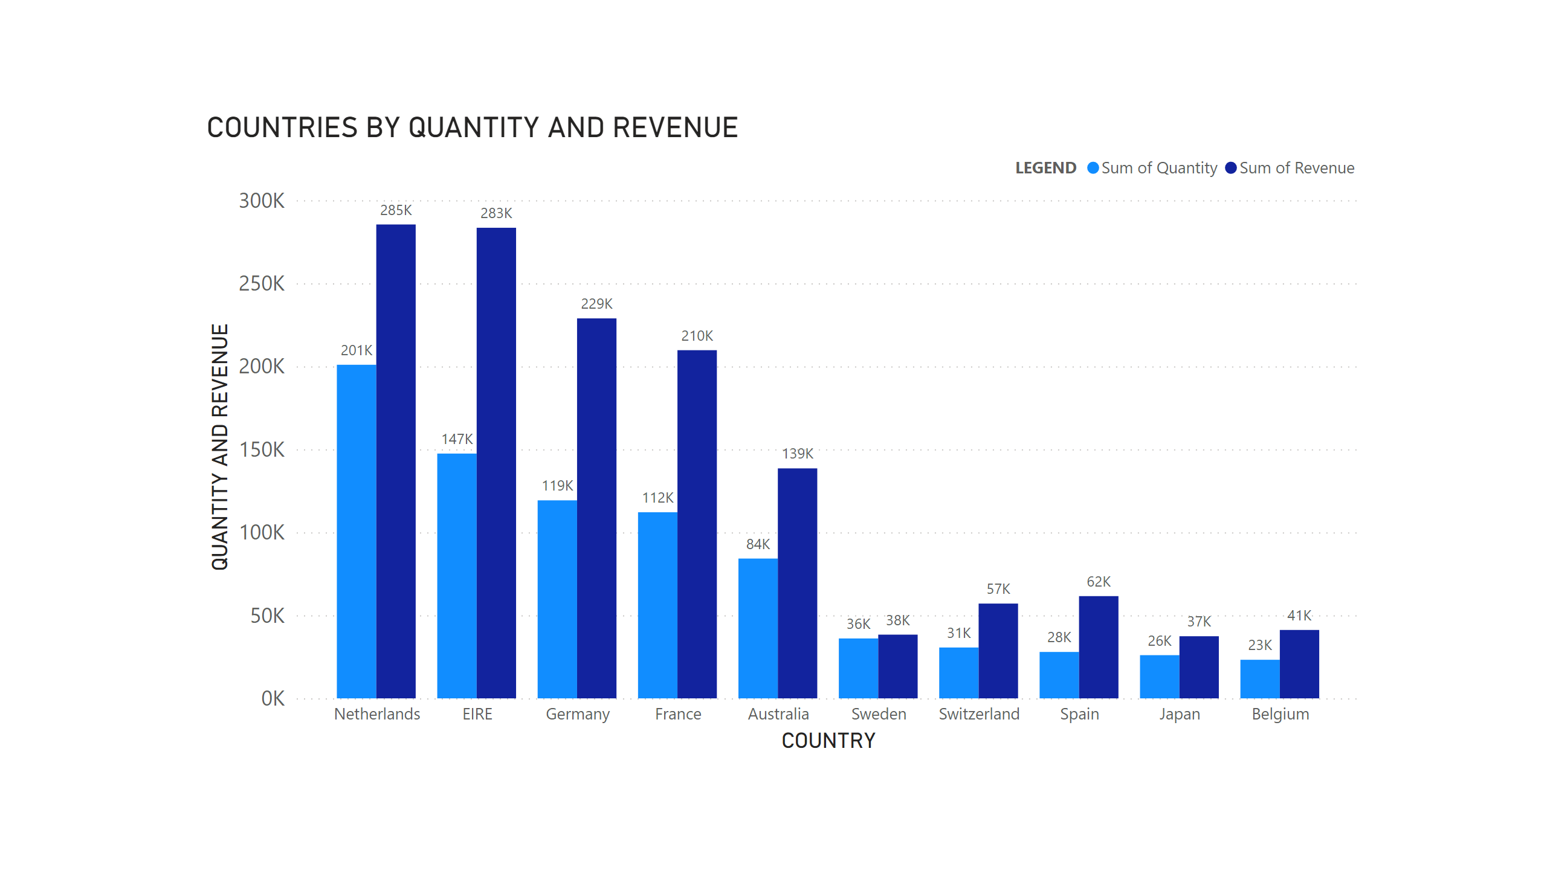
Ques2
Notes:
COUNTRIES BY QUANTITY AND REVENUE
No alt text provided

Slide 4
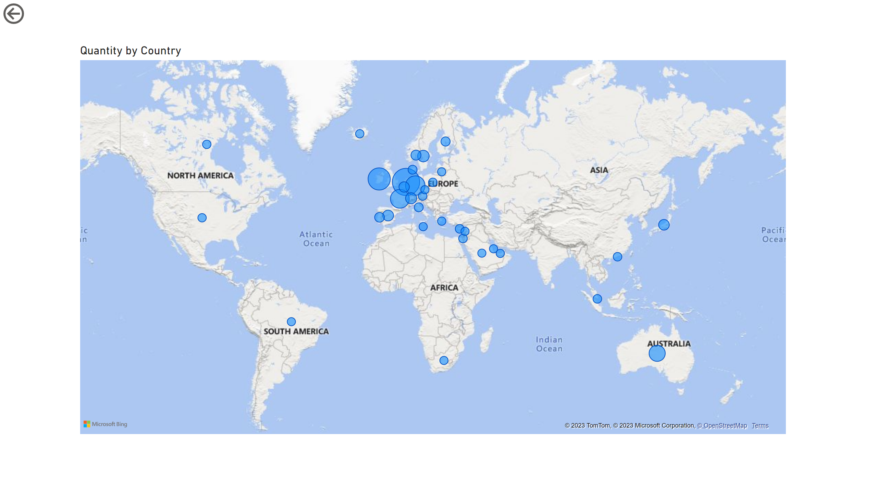
Ques4
Notes:
map
No alt text provided
actionButton
No alt text provided

